Slide 1
Statistical and Predictive Modeling 2
Assignment #3– Discriminant analysis Name: Paramvir singh Bali Student number: 100843502

Slide 2
Rational statement
In the given dataset there are 143 observation and 7 variables .
In this assignment, I will create both LDA and QDA models to forecast whether the person is happy or not.
Further I am presenting confusion matrix/classification report to check the efficiency of LDA and QDA.
In addition, I will optimized both LDA and QDA and compare them both.

Slide 3
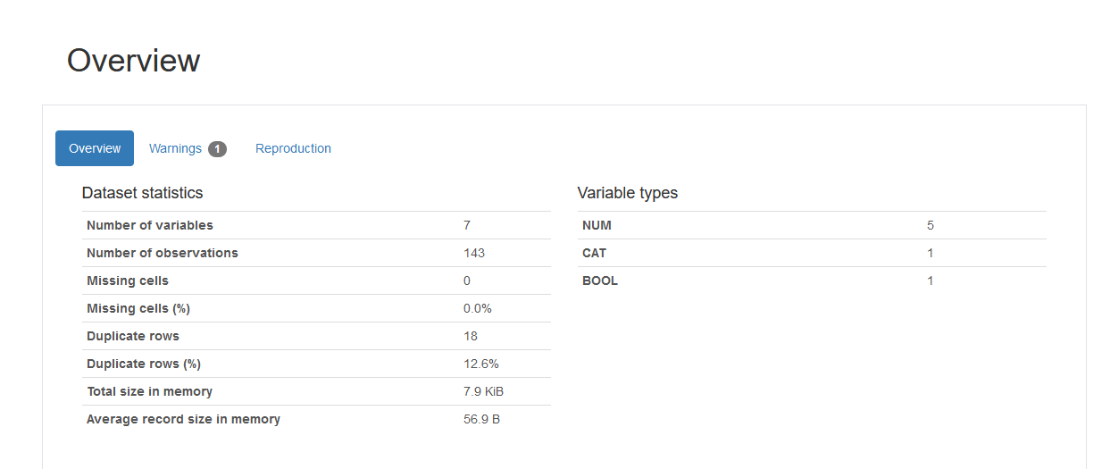
Two key Insight from pandas profile report
Overview from pandas profile:
overview generally give us the basic description of the dataset.
There are 7 missing columns,143 rows,0 missing values and 18 duplicate rows.7.9 kb is the size of the dataset in memory and 56.9 Byte is the size which every row occupies.
There are three types of variables/column namely numeric, categorical and boolean in which 5 are numeric column, 1 are the categorical and boolena column.

Slide 4
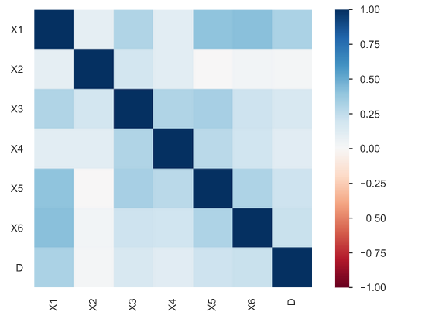
Two key Insight from pandas profile report
Correlations from pandas profile: correlations is used
for bivariate analysis between two independent variables. In the right heat map graph the more the dark shade of blue the more two variables are correlated for example x6(the availability of social community events) and X1(he availability of information about the city services) have dark blue color which means they are quite highly correlated whearas x2(the cost of housing ) and x6 (the availability of social community events) have white color(no blue) which means they are less correlated.

Slide 5
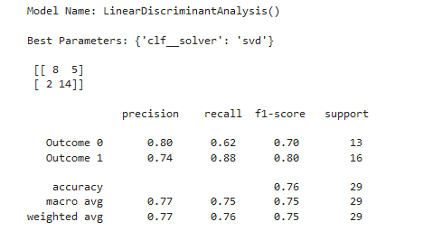
Presentation of the confusion metrics and classification report for the optimized LDA
Confusion matrix is N×N table(where N is the number of the classes) that contains number of incorrect and correct predictions of the classified model.
True negative: when both case and prediction is negative.Here 8 is the true negative means 8 times the model predicted unhappiness correctly out of 29 times .
True positive: when both case and prediction is positive. Here 14 is the value of true positive means 14 times model predicted happiness correctly out of 29 times.
False positive: when case is negative and prediction is positive.Here the value of false positive is 5. It means the 5 times the model is predicting happiness wrongly however it is unhappiness in reality.
False negative : when case is positive and prediction is negative. Here the value is 2. it means 2 times the model is predicting unhappiness wrongly however it is happiness.

Slide 6
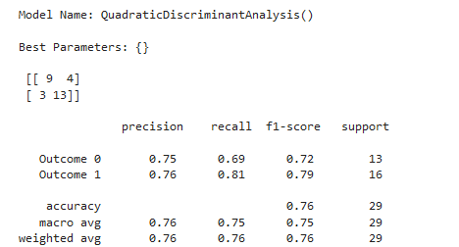
Presentation of the confusion metrics and classification report for the optimized QDA
True negative: when both case and prediction is negative.Here 9 is the true negative means 9 times the model predicted unhappiness correctly out of 29 times .
True positive: when both case and prediction is positive. Here 13 is the value of true positive means 13 times model predicted happiness correctly out of 29 times.
False positive: when case is negative and prediction is positive.Here the value of false positive is 4. It means the 4 times the model is predicting happiness wrongly however it is unhappiness in reality.
False negative : when case is positive and prediction is negative. Here the value is 3. it means 3 times the model is predicting unhappiness wrongly however it is happiness.

Slide 7
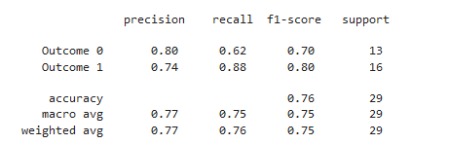
Three key insights(precision,recall,f1score) from LDA
Precision means what proportion of predicted positives is truly positive.
Precision = truly positive/(truly positive +false negative)
The weighted average precision for this 77% efficient which is quite good. The value of the weighted average precision explains that only 77% of the predicted positive of this model are actually detected as true value and rest 23% predicted value are not actually detected as true positive.
Recall explain what proportion of actual positive is classified or detected.
Recall = true positive/ (true positive+false positive)
The weighted average recall for this model is 76% efficient which is quite high. The value of the weighted average recall explain that only 76% of actual positive is detected and rest 24% predicted value are not actual positive.
F1 score is the harmonic mean of precision and Recall. It is the combination of precision and Recall.
We use F1 score because there is always a trade off between Recall and precision ie if we train our model to increase precision then Recall will decrease and vice versa.
The weighted average F1 score for SVM algorithm is 75% efficient which is quite high

Slide 8
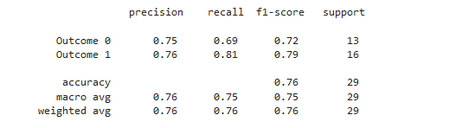
Three key insights(precision,recall,f1score) from QDA
Precision means what proportion of predicted positives is truly positive.
Precision = truly positive/(truly positive +false negative)
The weighted average precision for this 76% efficient which is quite good. The value of the weighted average precision explains that only 76% of the predicted positive of this model are actually detected as true value and rest 24% predicted value are not actually detected as true positive.
Recall explain what proportion of actual positive is classified or detected.
Recall = true positive/ (true positive+false positive)
The weighted average recall for this model is 76% efficient which is quite high. The value of the weighted average recall explain that only 76% of actual positive is detected and rest 24% predicted value are not actual positive.
F1 score is the harmonic mean of precision and Recall. It is the combination of precision and Recall.
We use F1 score because there is always a trade off between Recall and precision ie if we train our model to increase precision then Recall will decrease and vice versa.
The weighted average F1 score for SVM algorithm is 76% efficient which is quite high

Slide 9
Comparision of optimized LDA to the optimized QDA by three key insights
The weighted average precision for the LDA is 77% efficient whearas for the QDA it is 76 % which means in case of precision LDA performs slightly weel.
The weighted average recall for both LDA and QDA is same which 76%. Thus in case of recall both performs the same.
The weighted average f1 score for LDA is 75% whearas for QDA it is 76% which further means that latter performs better than the formal.
The higher the dimension of the data set (the more predictors in a data set) the more parameters we have to estimate. This can lead to high variance and so we have to be careful when using QDA.But in our dataset we don’t have higher number of predictors/columns that’s why our in our case both LDA and QDA performs almost the same however there is slight difference in the performance metrics(precision,recall and f1 score).

Slide 10
Two recommendatios for mr hughes
LDA and QDA works better when the response classes(dependent variable) are seperable and distribution for all classes are gaussian(normal). The more the classes are separable and the more the distribution is normal, the better will be the classification result for LDA and QDA.Overall, our classes in the dataset should be quite separated and distributed normally for the better performance of both LDA and QDA.
LDA and QDA performs well if we collect more data i.e independent varaiables/ columns which are useful(not redundant) which helps to improve the performance metrics and overall improve performance of the metrics.

Slide 11
References
Week5 - Data2204-Notes
https://thatdatatho.com/linear-vs-quadratic-discriminant-analysis/
An Introduction to Statistical Learning-Springer Texts in Statistics E book

